Slide 1
Informacioni sistemi
Servisna Magistrala Preduzeća - primeri -
Prof. Dr Milorad Tošić
Katedra za Računarstvo,
Elektronski fakultet, Univerzitet u Nišu

Slide 2
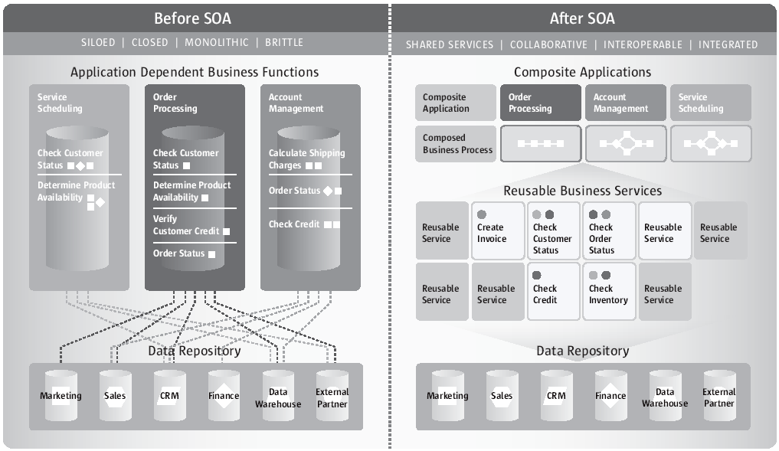
Servisima Orijentisana Arhitektura
USING OPEN-SOURCE SOA IN AN ENTERPRISE DEPLOYMENT, White Paper, 2009, by Sun Microsystems Inc.

Slide 3
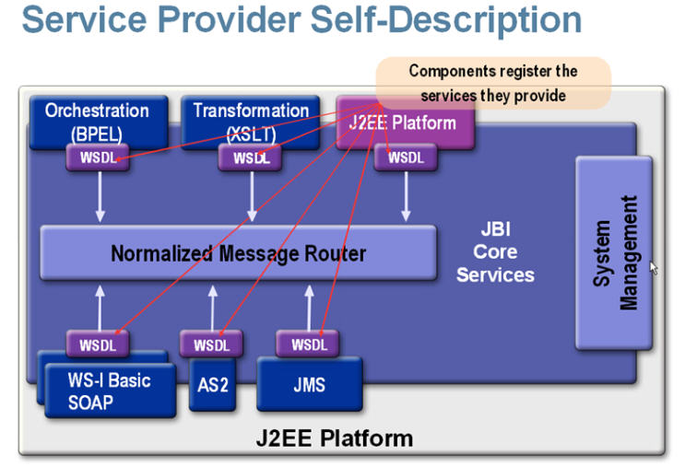
Servisima Orijentisana Arhitektura
OpenAPI
AS2 (Applicability Statement 2) is a http based protocol to transmit messages (especially EDI messages).
OpenESB/GlassfishESB Introduction Tutorial, http://wiki.open-esb.java.net/Wiki.jsp?page=OpenESBIntroductionTutorial.

Slide 4
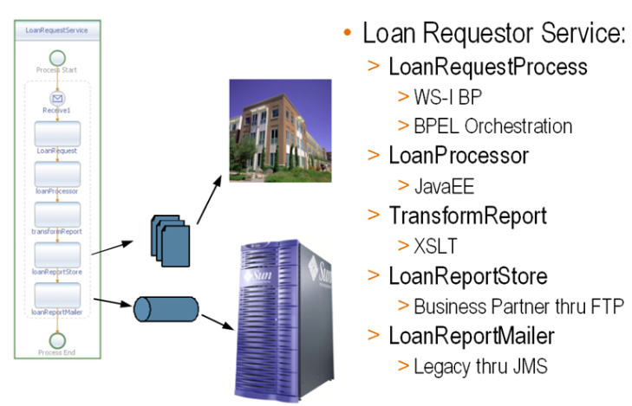
Servisima Orijentisana Arhitektura
OpenESB/GlassfishESB Introduction Tutorial, http://wiki.open-esb.java.net/Wiki.jsp?page=OpenESBIntroductionTutorial.

Slide 5
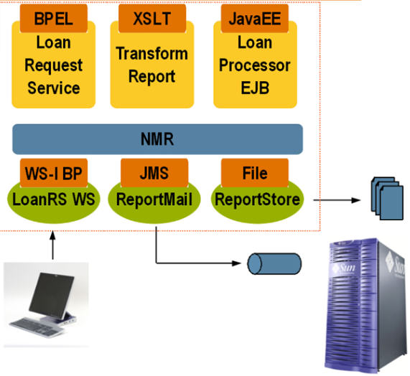
Servisima Orijentisana Arhitektura
OpenESB/GlassfishESB Introduction Tutorial, http://wiki.open-esb.java.net/Wiki.jsp?page=OpenESBIntroductionTutorial.

Slide 6
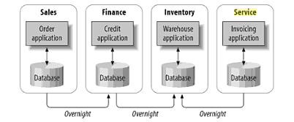
Primer: Uvodjenje ESB-a
Enterprise Service Bus, by David Chappell

Slide 7
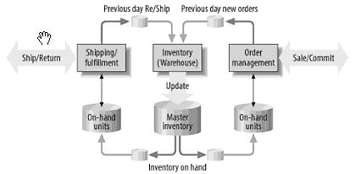
Primer: Uvodjenje ESB-a
Enterprise Service Bus, by David Chappell

Slide 8
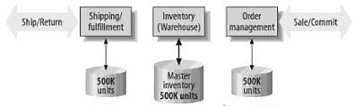
Primer: Uvodjenje ESB-a
Dan 1
500K
500K
500K
1
Mušterija A: narudžbina od 400k proizvoda i obaveza isporuke
Enterprise Service Bus, by David Chappell

Slide 9
Primer: Uvodjenje ESB-a
Dan 2
400K
100K
100K
1
Mušterija B: povraćaj od 300k proizvoda
Mušterija C: narudžbina od 400k proizvoda.
ODBIJENO
2
Enterprise Service Bus, by David Chappell

Slide 10
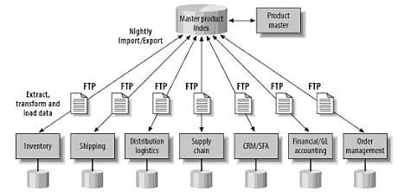
Primer: Uvodjenje ESB-a
Enterprise Service Bus, by David Chappell

Slide 11
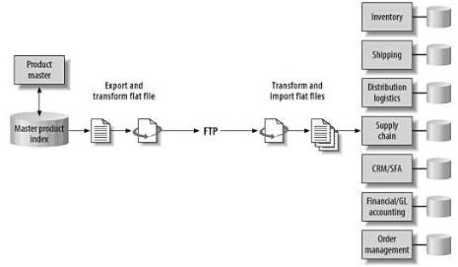
Primer: Uvodjenje ESB-a
Enterprise Service Bus, by David Chappell

Slide 12
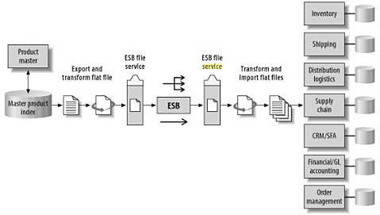
Primer: Uvodjenje ESB-a
Enterprise Service Bus, by David Chappell

Slide 13
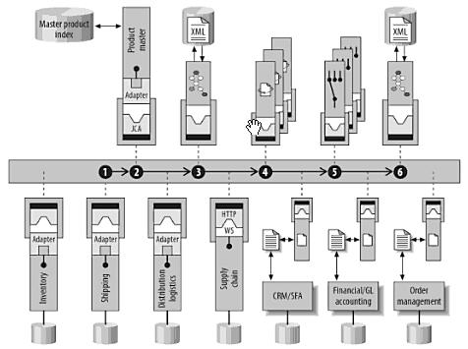
Primer: Uvodjenje ESB-a
Enterprise Service Bus, by David Chappell

Slide 14
Aktivnosti na predavanjima
Strana http://infosys3.elfak.ni.ac.yu/nastava/Wiki.jsp?page=ISNP_PredavanjaStudentiZadaci0809
Pregled aktivnosti studenata do sada: problemi i planovi
Planiranje studentskih prezentacija

